Slide 1
Group 1
Ruben Holthuijsen (1064459)
Sander van Swieten (1063788)
Vince van Doorn (1061669)
Victor de Sousa Gama (0929470)
Kevin Hartman (1044032)
TYPOGRAPH TEST
Group 1
Ruben Holthuijsen (1064459)
Sander van Swieten (1063788)
Vince van Doorn (1061669)
Victor de Sousa Gama (0929470)
Kevin Hartman (1044032)
Group 1
Ruben Holthuijsen (1064459)
Sander van Swieten (1063788)
Vince van Doorn (1061669)
Victor de Sousa Gama (0929470)
Kevin Hartman (1044032)
Group 1
Ruben Holthuijsen (1064459)
Sander van Swieten (1063788)
Vince van Doorn (1061669)
Victor de Sousa Gama (0929470)
Kevin Hartman (1044032)
Group 1
Ruben Holthuijsen (1064459)
Sander van Swieten (1063788)
Vince van Doorn (1061669)
Victor de Sousa Gama (0929470)
Kevin Hartman (1044032)

Slide 2
Intentionally left blank

Slide 3
RNA sequencing-based Machine Learning for Detection of
Triple Negative Breast Cancer
Ruben Holthuijsen (1064459) • Sander van Swieten (1063788) • Vince van Doorn (1061669)
Victor de Sousa Gama (0929470) • Kevin Hartman (1044032)

Slide 4
Outline
TODO - Opleuken met icoontjes
Context
Approach
Results
Discussion

Slide 5

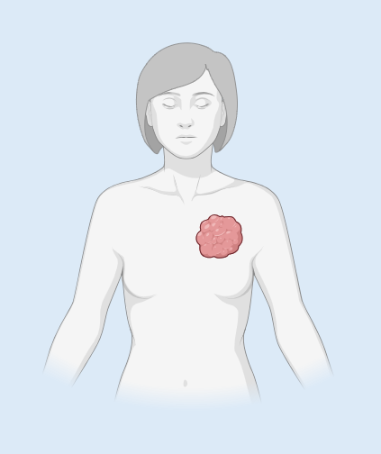
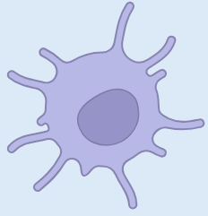


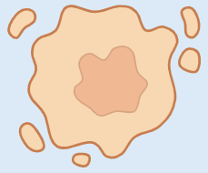

Context
2.300.000 cases of breast cancer worldwide in 2022
TNBC - Overview
Women younger than 40 years of age are highest risk
Triple-Negative Breast Cancer
~10-20% of breast cancer
Triple-Negative Breast Cancer (TNBC)
Breast Cancer
(BC)
ER (ESR1)
/
PGR (PGR)
/
HER2 (ERBB2)
/

Slide 6
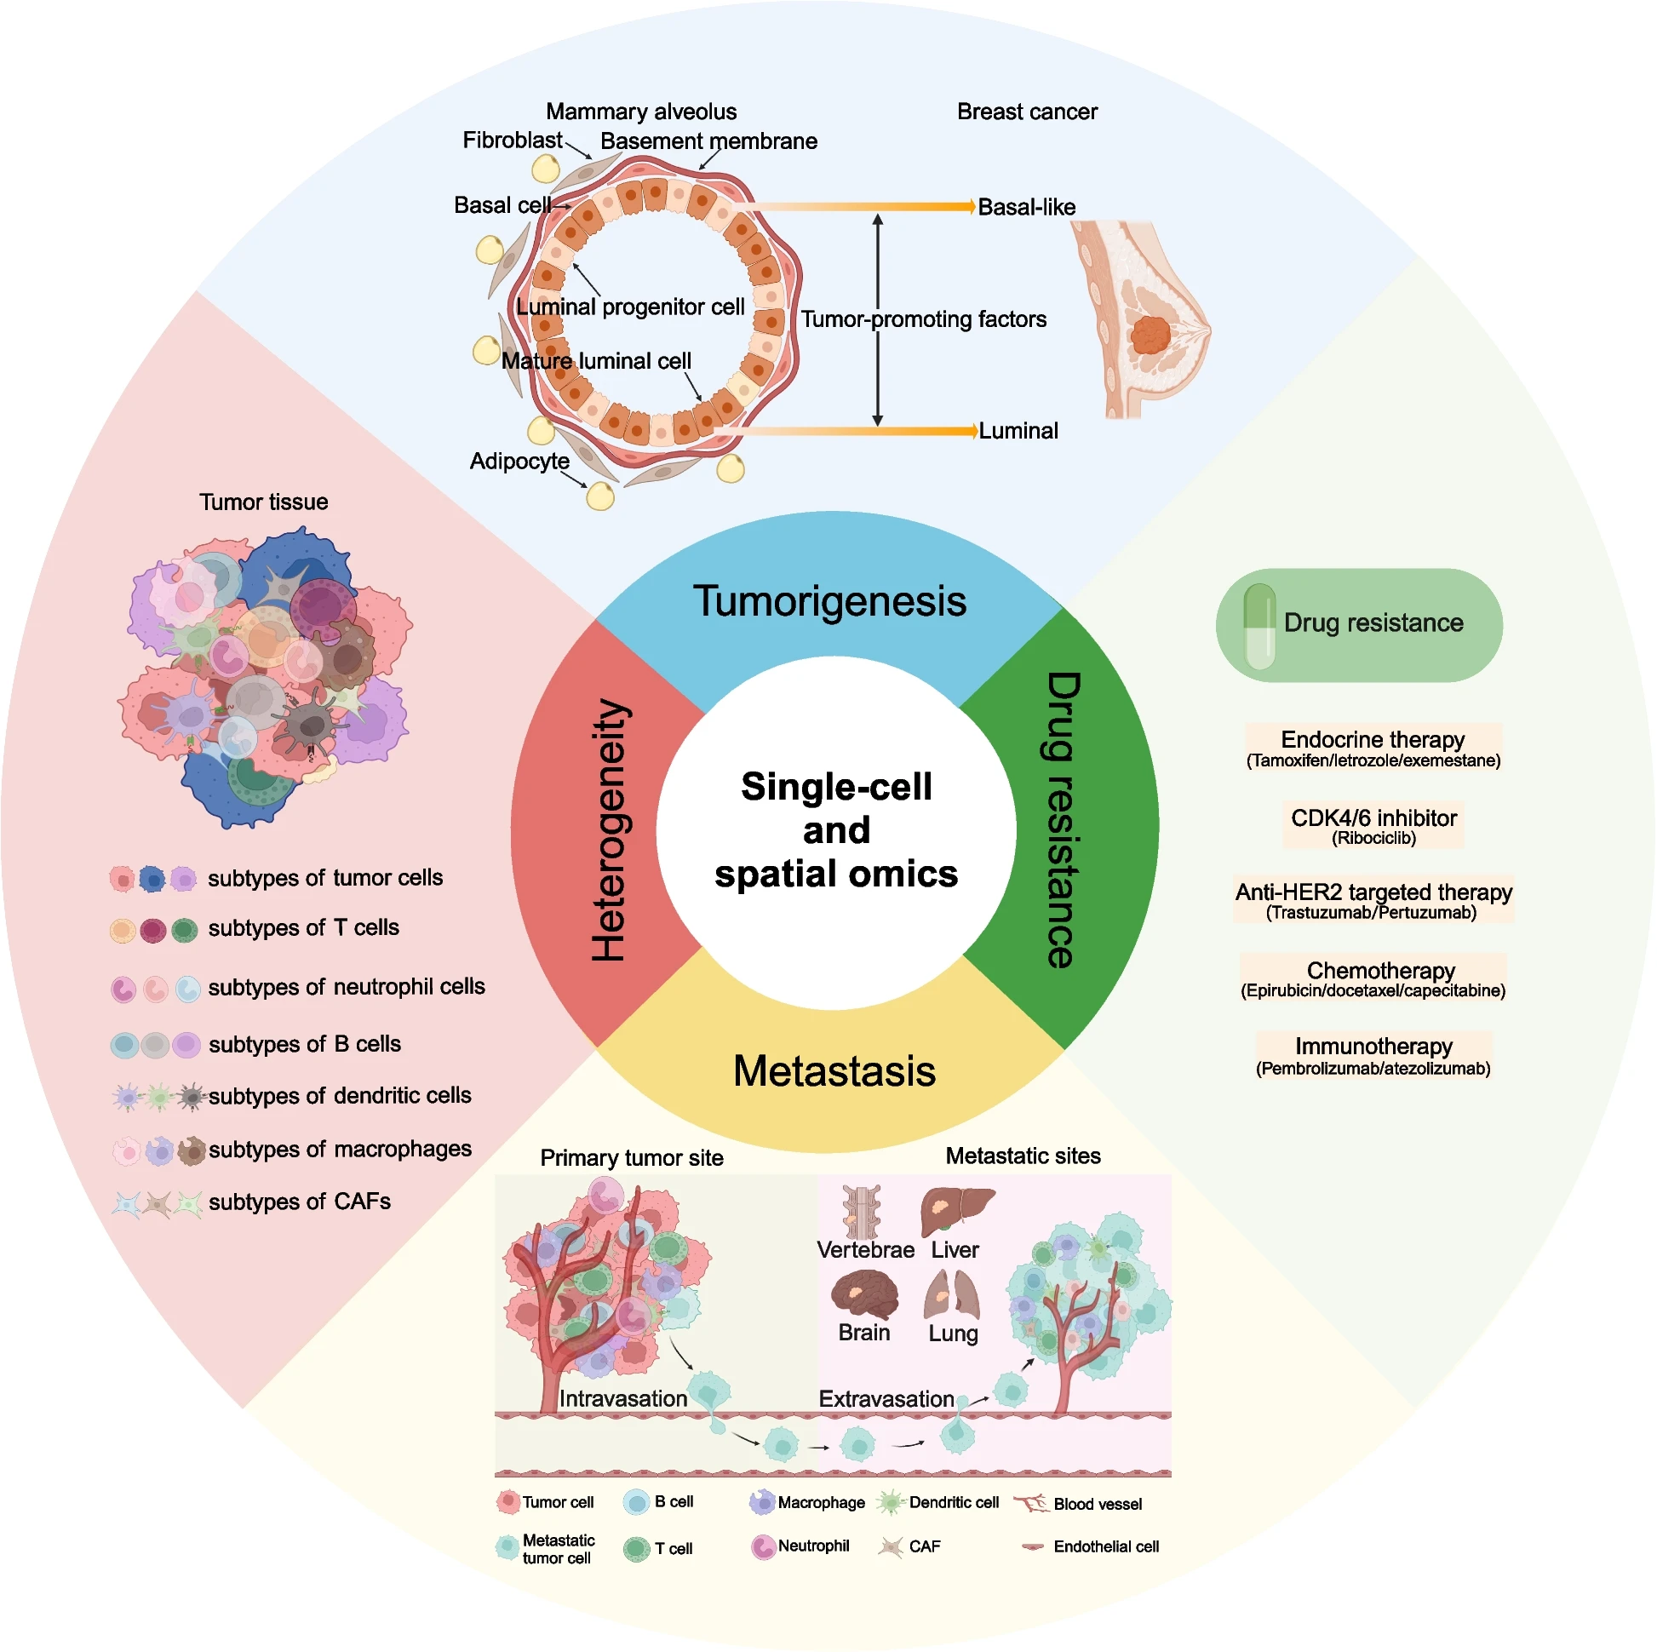
Context
TNBC - Overview
Source:
Xiong et al. Biomarker Research (2024) 12:107
doi 10.1186/s40364-024-00654-1

Slide 7
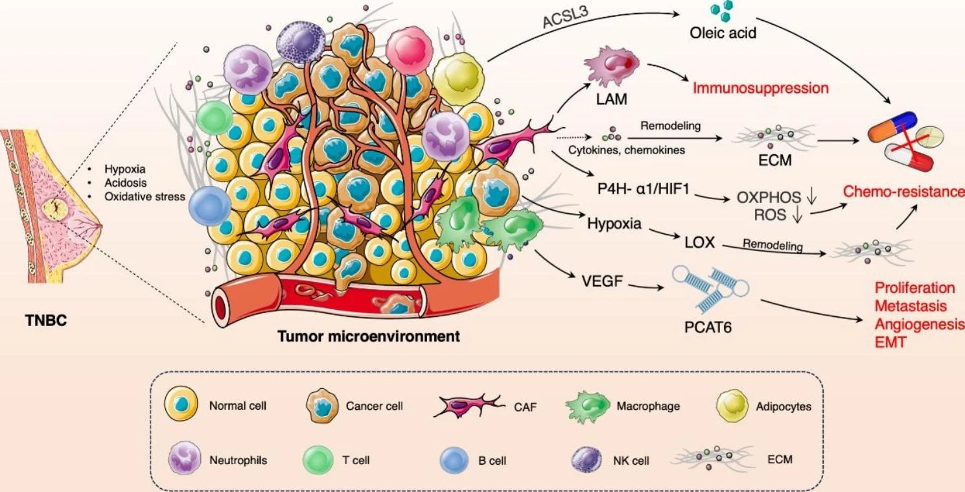
Context
TNBC – Tumor Microenvironment (TME)
Source:
Liu et al. Molecular Cancer (2023) 22:145
doi 10.1186/s12943-023-01850-7

Slide 8
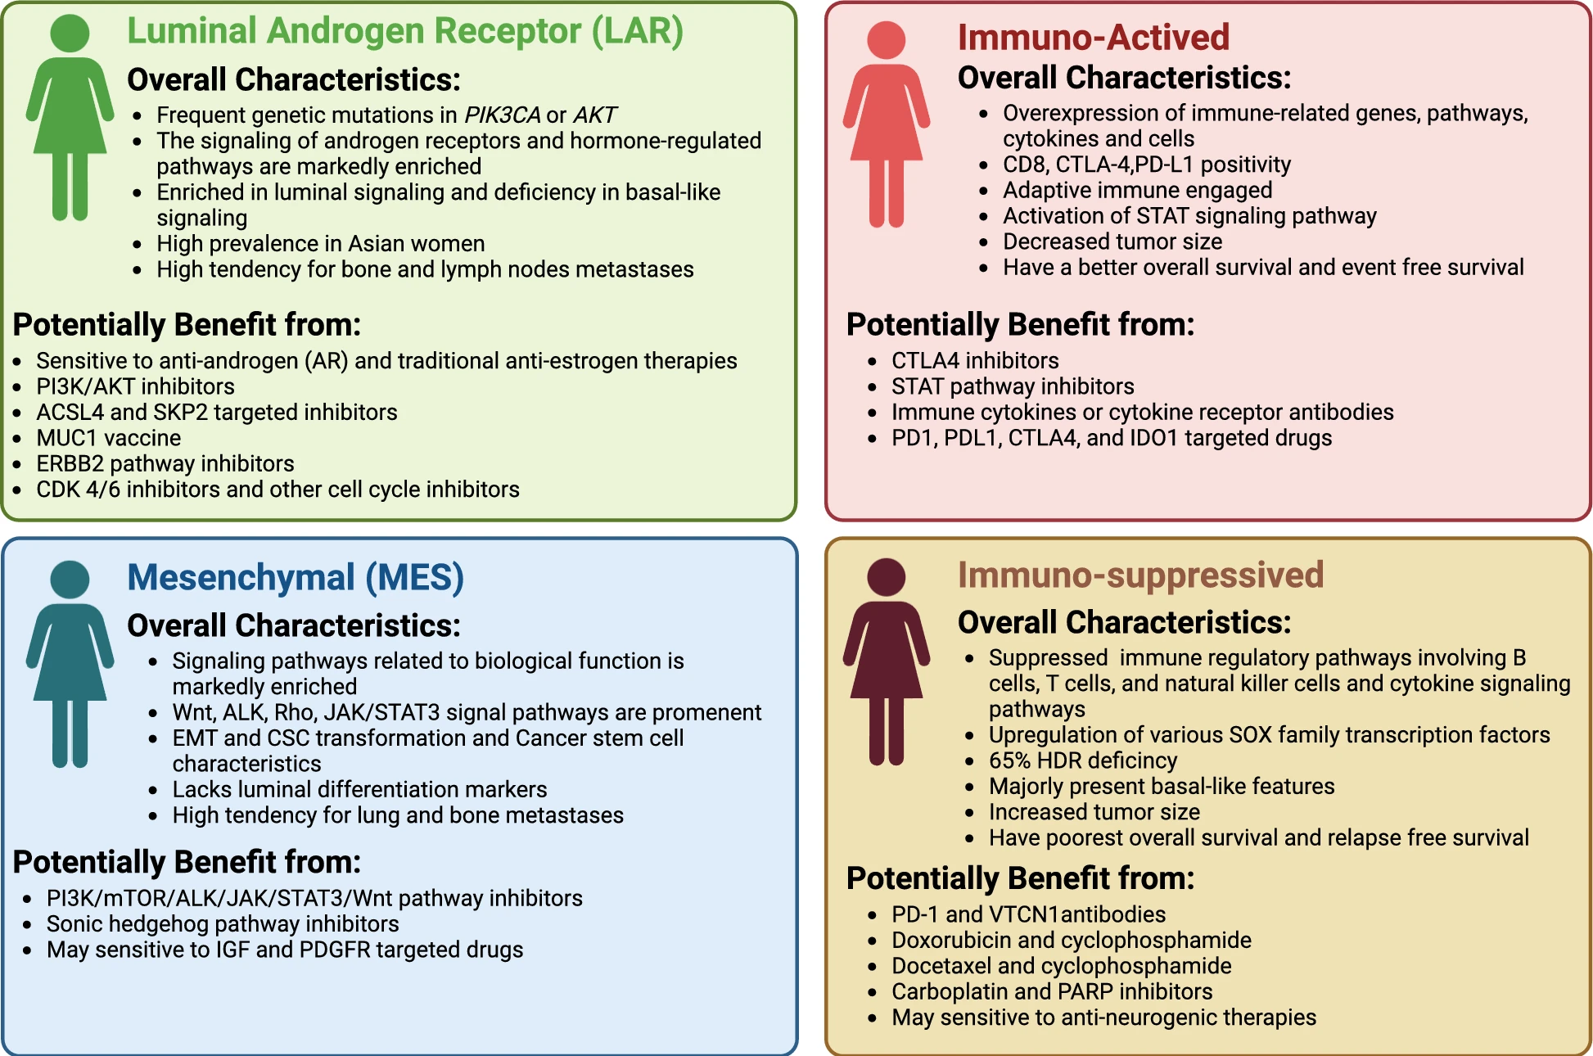
Context
TNBC – Subtyping
Source:
Chen et al. Cell & Bioscience (2025) 15:13
doi 10.1186/s13578-025-01359-0

Slide 9
Approach
Project

Slide 10
Approach
Machine Learning

